Slide 1
ACS 560 Course Project: Calor Mobile Application
Kevin Villela
Phillip Bercot

Slide 2
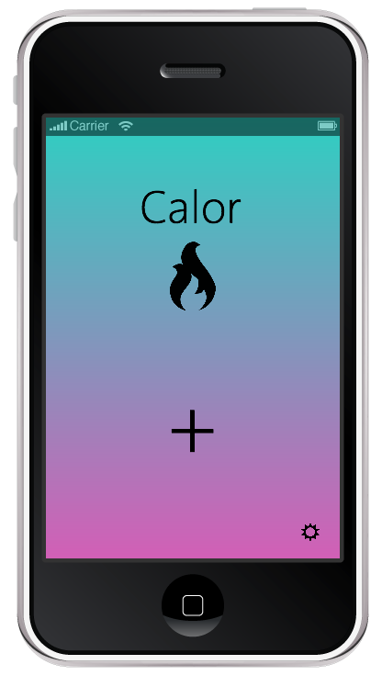
Start Page

Slide 3
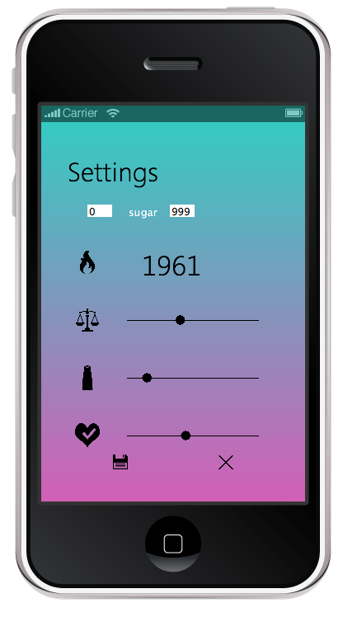
Settings Page

Slide 4
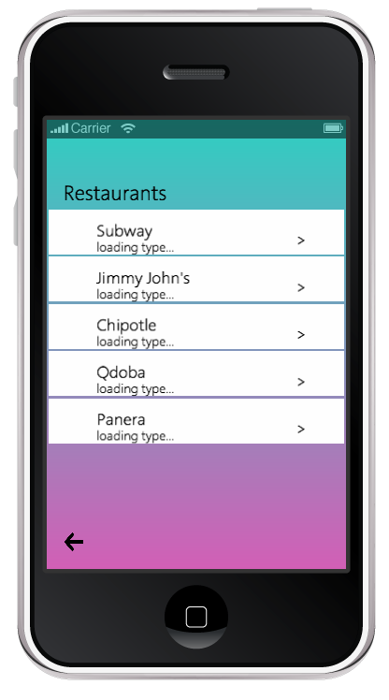
Restaurants Page

Slide 5
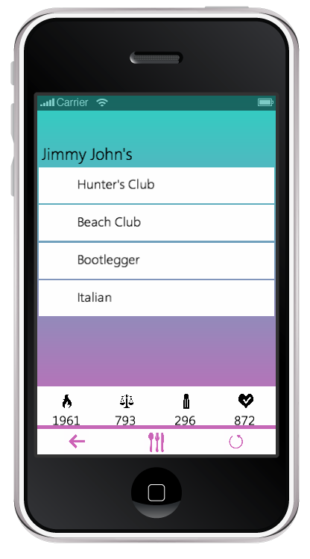
Meals Page

Slide 6
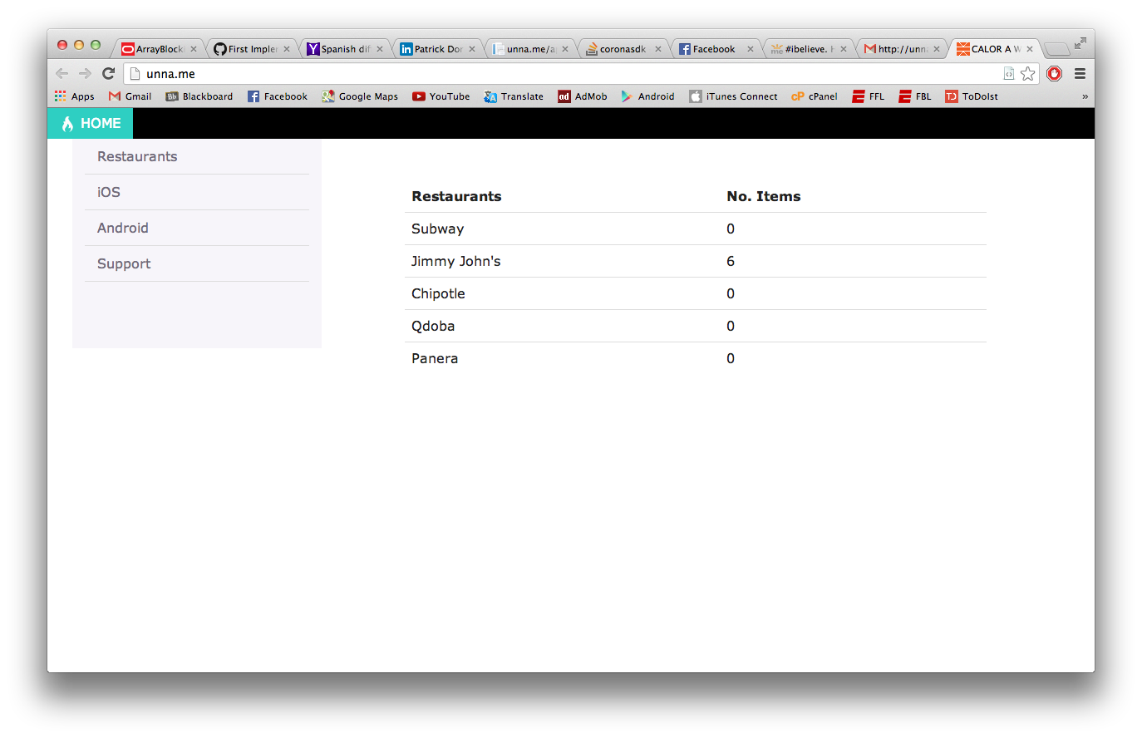
Web API

Slide 7
Q&A
Any questions?

